Slide 1
qechackethz24/
quantumquants
ETH Quantum Hackathon
Moody's x QuEra Challenge
Peter Ivashkov
Francesco Ruscio
Grecia Castelazo
Alexander Jürgens
May 5, 2024

Slide 2
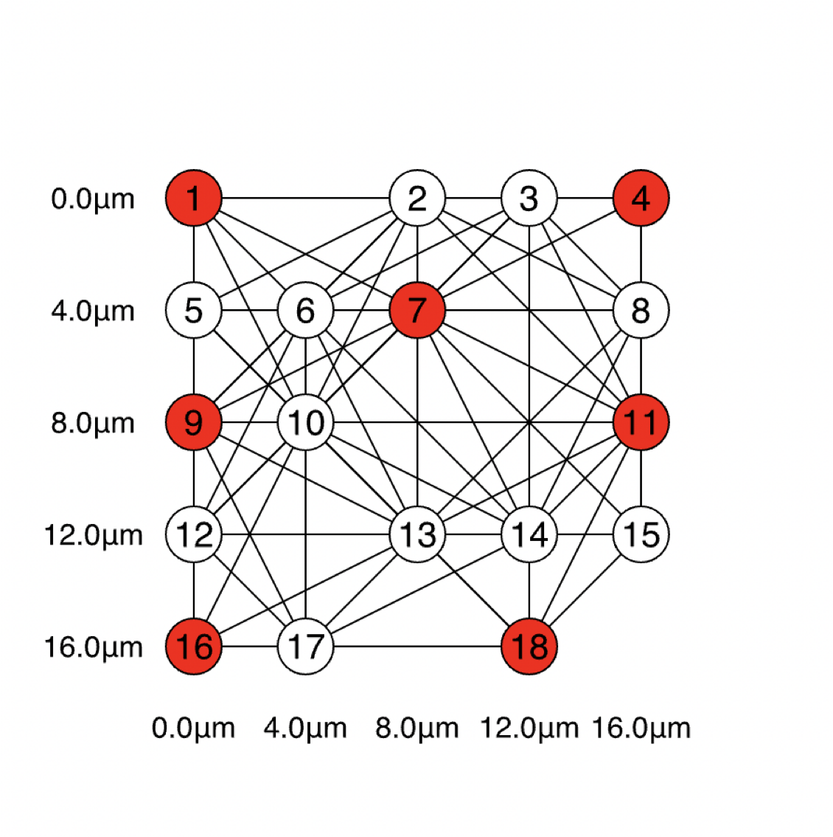
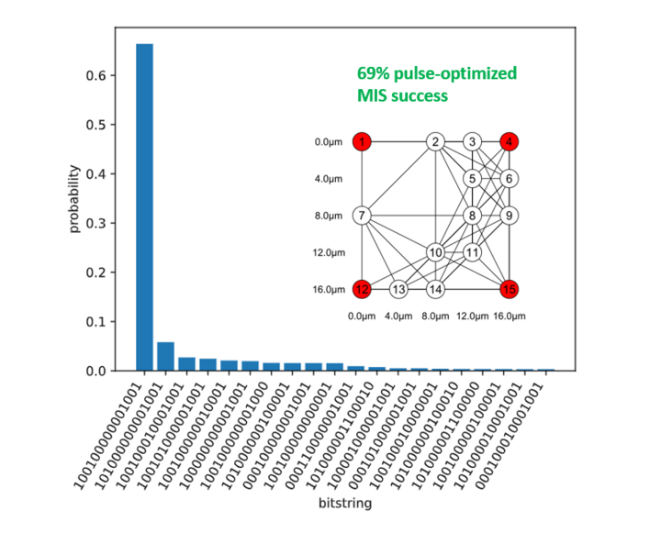
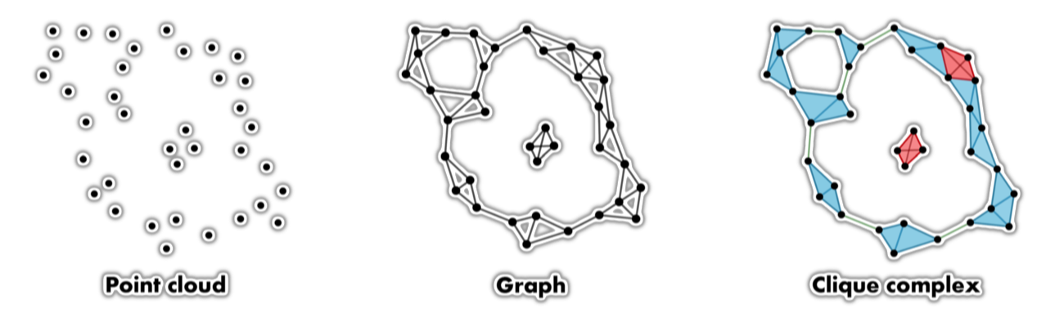
Our story
Problem
Simulations and experiments
Application proposal

Slide 3
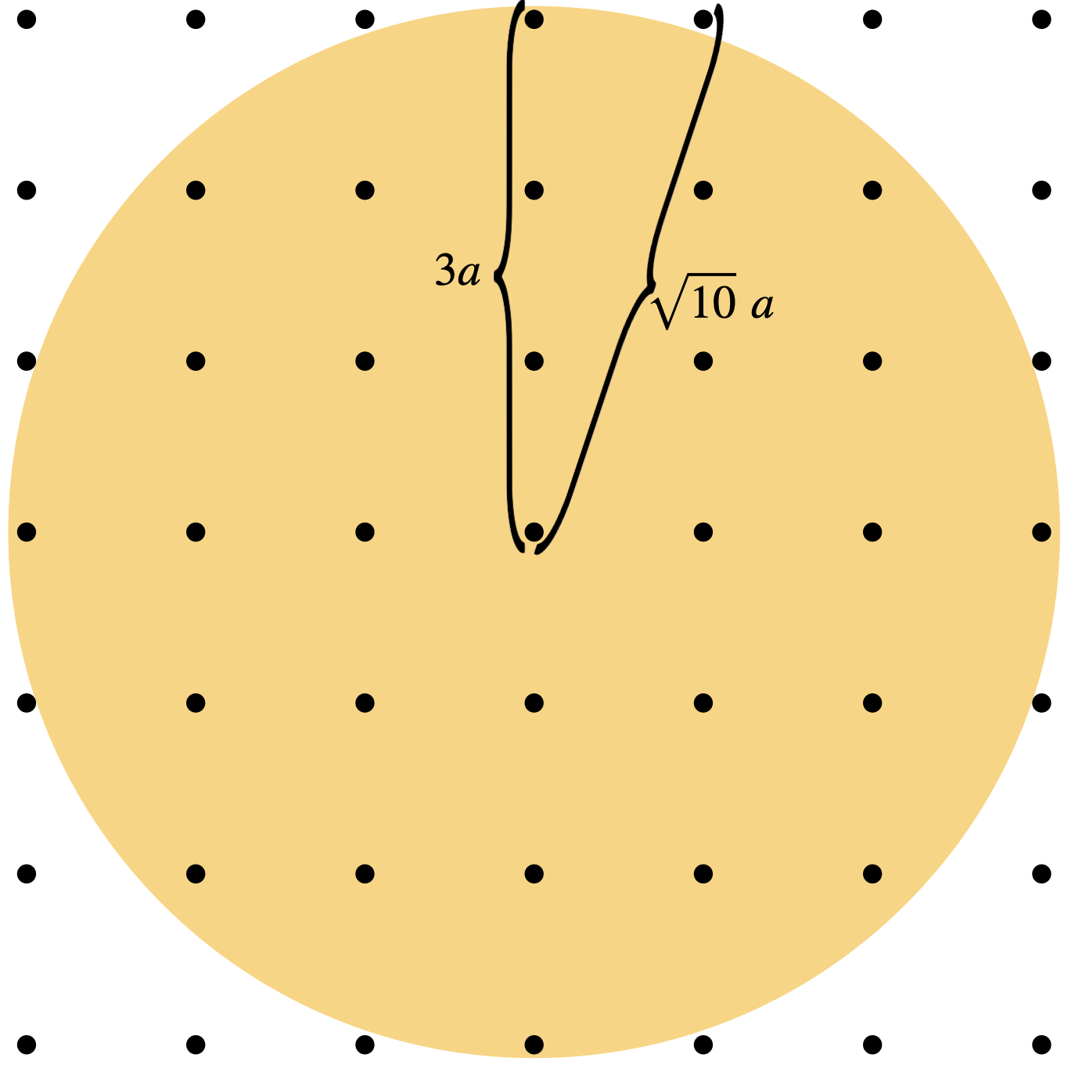
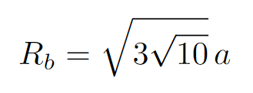
The Problem
Extension of defective king's
graph problem

Slide 4
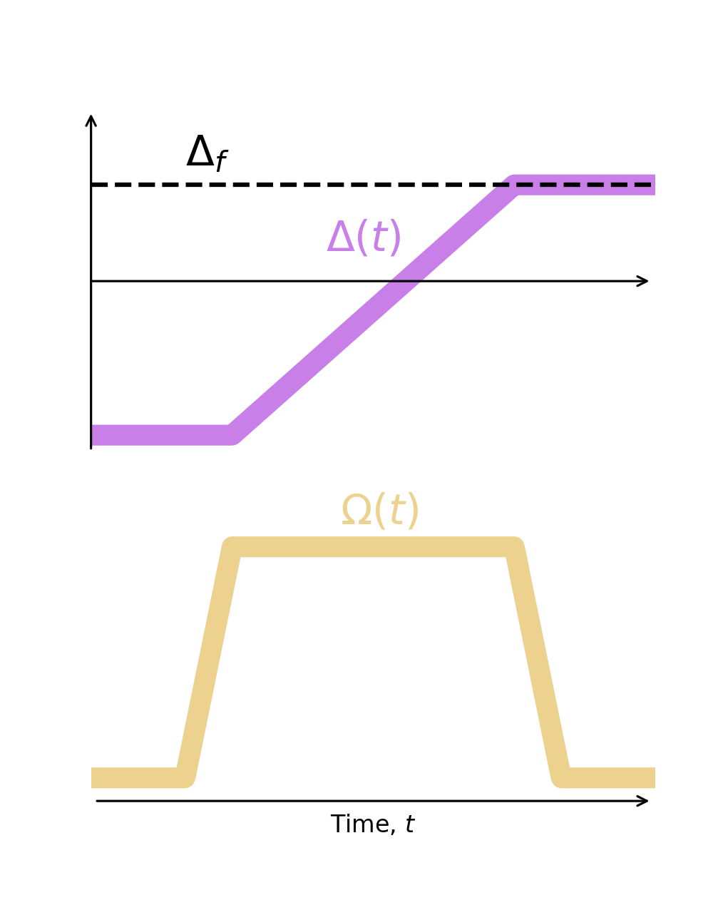
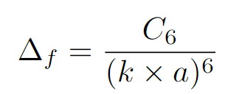
The Problem
Extension of defective king's
graph problem

Slide 5
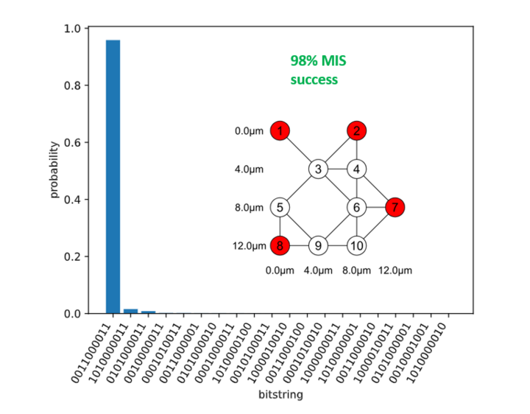
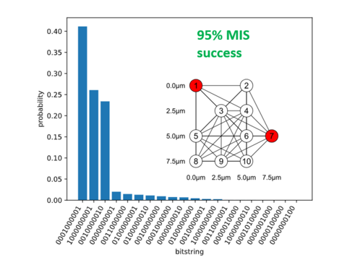
Simulations
King's Lattice
Rb/a > 3
No classical pulse-optimization
No classical pulse-optimization
Lattice constant = 4
Lattice constant = 2.5

Slide 6
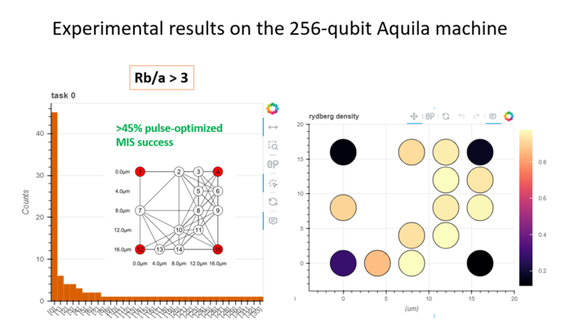
Rb/a > 3
Hardware experiments
Classical schedule optimization
Experimental results
Classically predicted 69% success probability
Over 45% success probability on a 15-qubit experiment

Slide 7
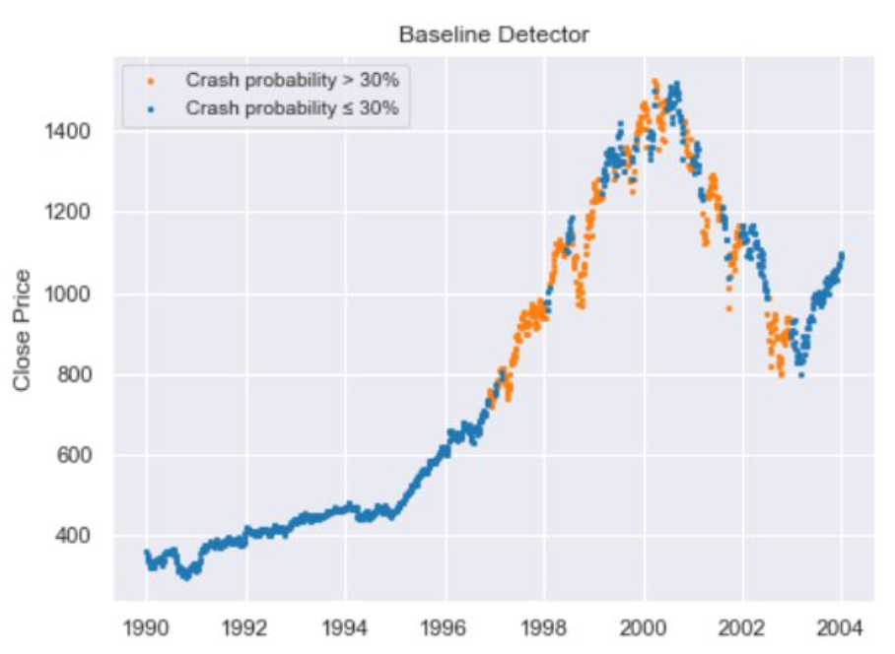
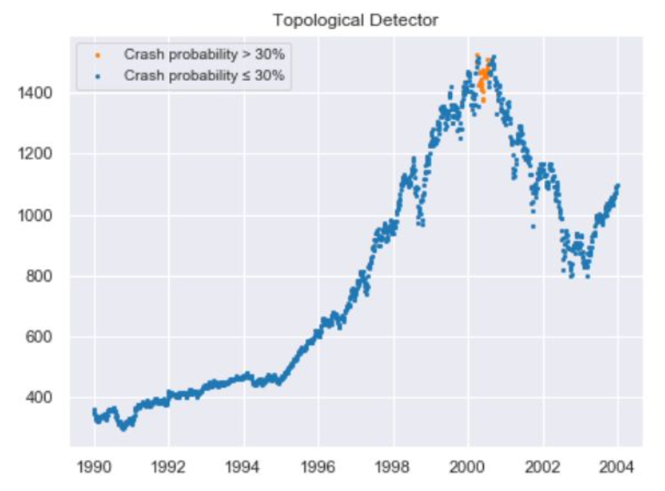
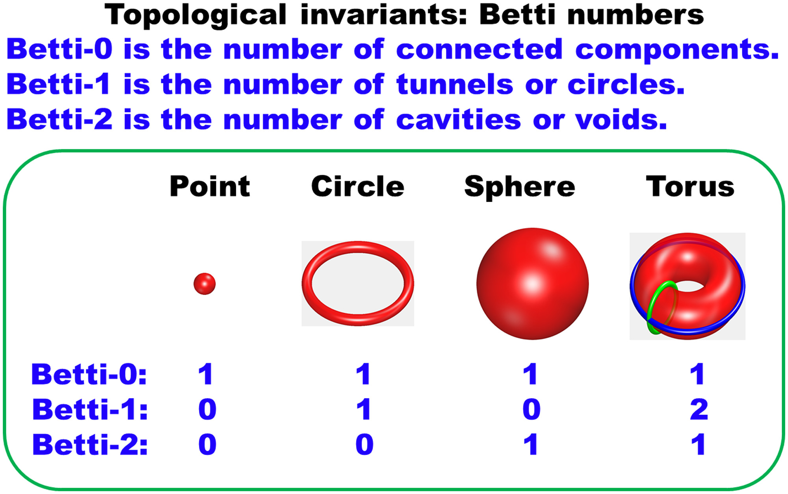
Market Crash Prediction
Quantum Application : Betti Numbers
Topological properties of data clouds have shown predictive power for coming financial crashes in 2000, 2008, 2019 and more.
Prime example: Persistence Landscapes
Higher dimensional number of holes
Determining an arbitrary Betti number is #P - hard
Betti numbers of some financial datasets have been shown detectable anomalies before crashes
pubmed.ncbi.nlm.nih.gov/34573837/
arxiv.org/pdf/1810.04963

Slide 8
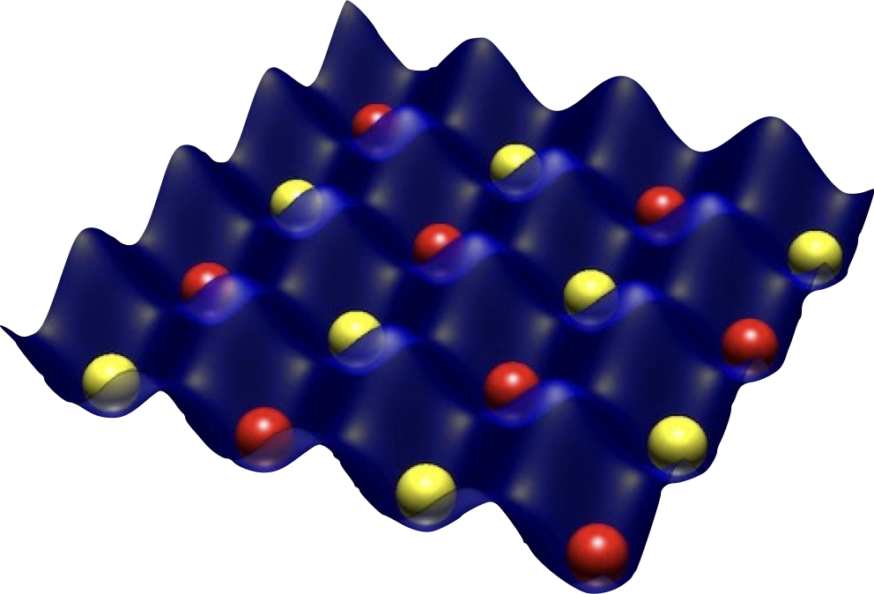


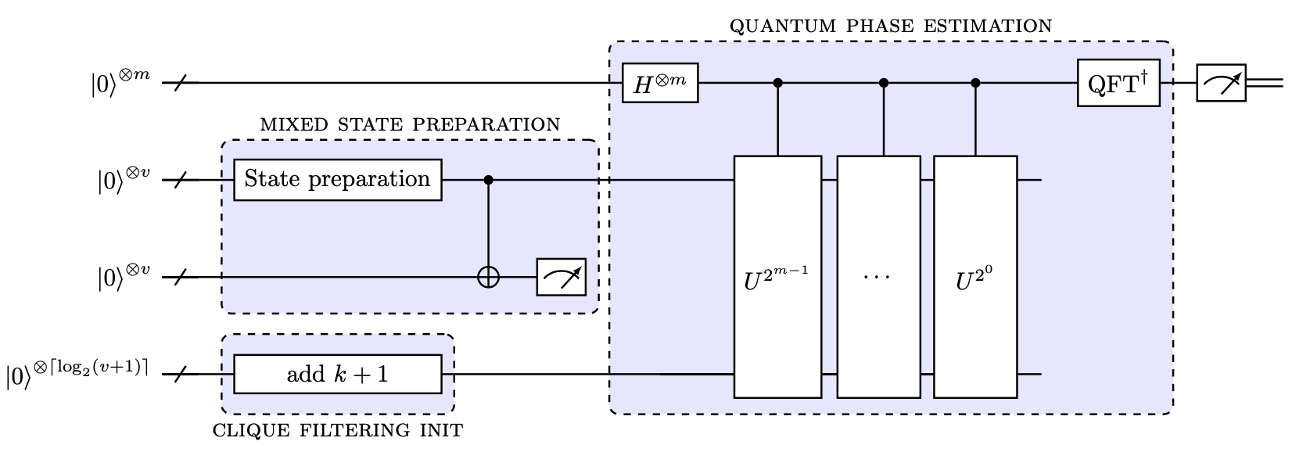

The Quantum TDA Pipeline
(x,y)∈V⇔
implement compli-
X⊂G k-Clique ⇔
d(x,y)<ε
mentary Graph G'
X⊂G' k-Independent
Point cloud
Graph
MIS Calculation
LGZ Algorithm
Alert politicians
Save the world
(optional)​
Betti number
high dimensional hole
of a simplicial complex
arXiv:2209.14286v2 [quant-ph]

Slide 9
THANK YOU FOR YOUR ATTENTION!​
Answering any questions might be #P - hard…​

Slide 10
BONUS

Slide 11
Example:TDA for Financial Time Series
(x,y)∈V⇔
Solve NP Hard max
d(x,y)<ε
Clique problem class.
Point cloud
matrix of d x c matrix
Graph
Simplicial Clique Complex
Data input:
d time series with a sliding window of size c
over stock charts calculating L1,L2 Banach
representations​
d: # of columns (# of 1D time series)
c: # length of the column

Slide 12
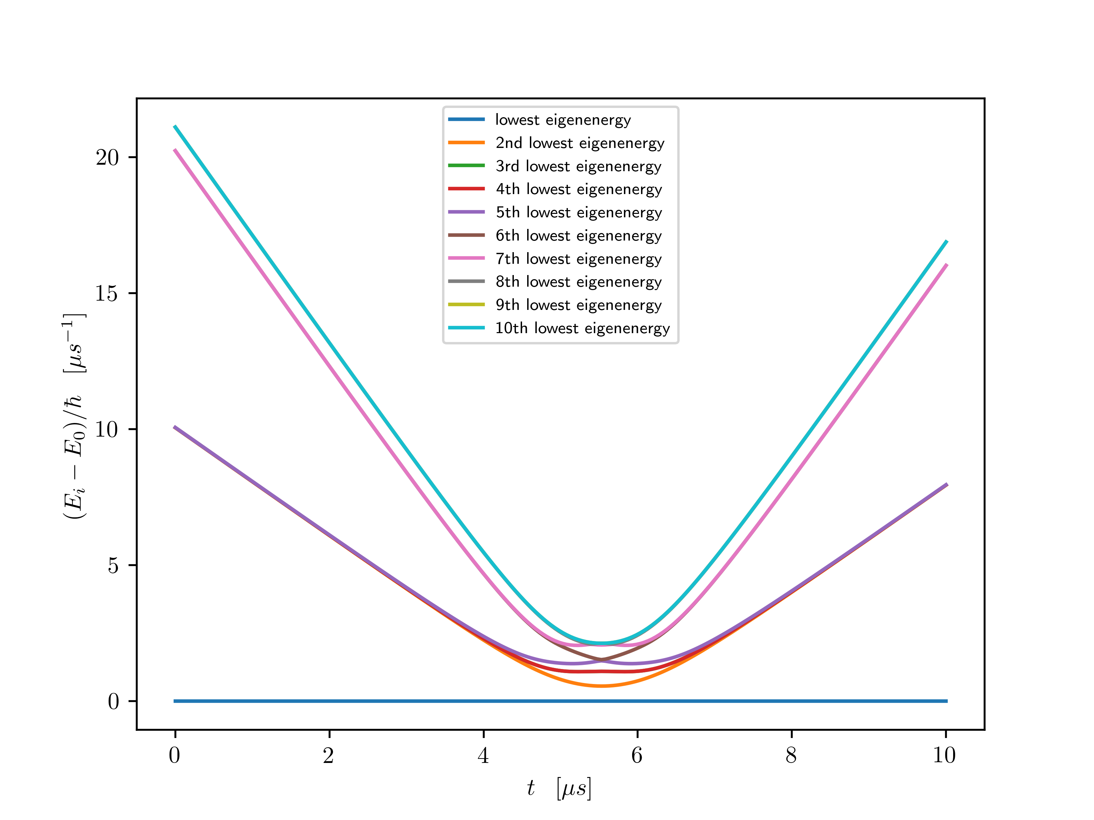
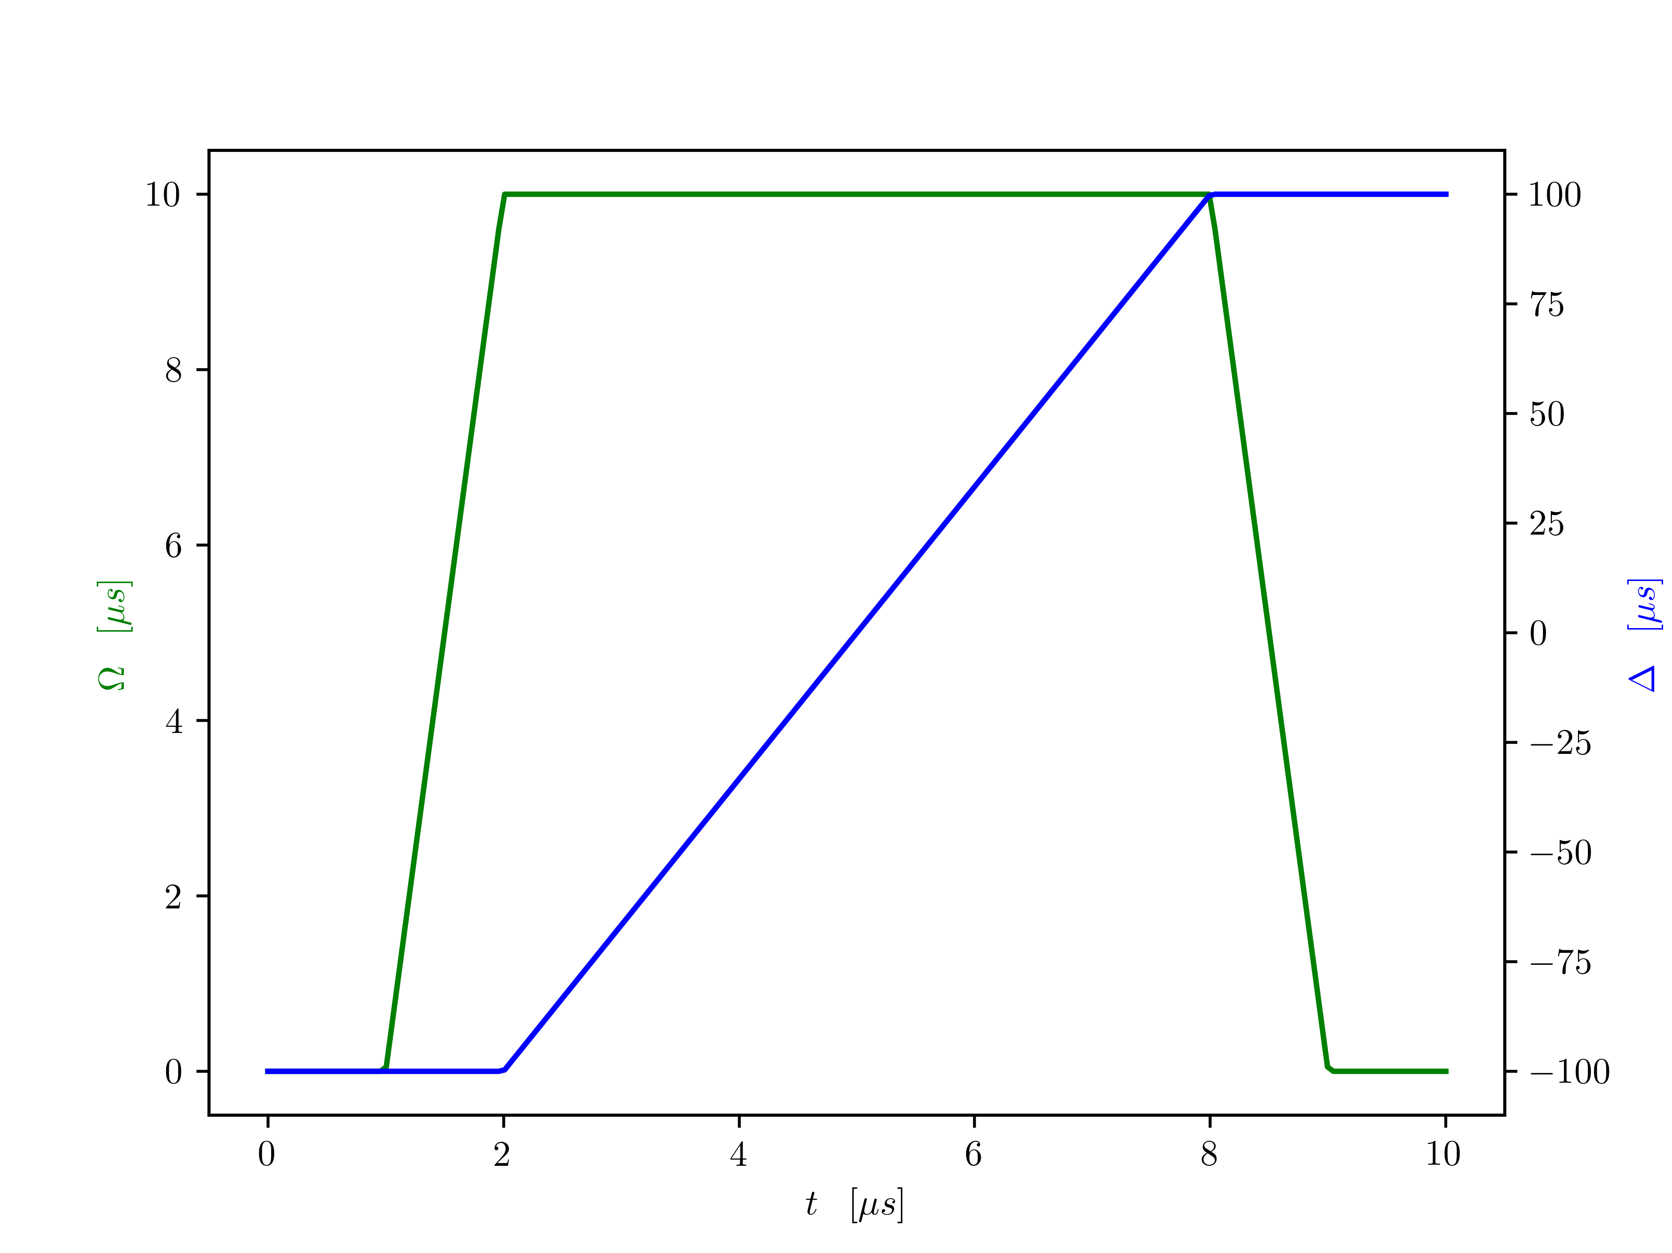
Adiabaticity?

Slide 13
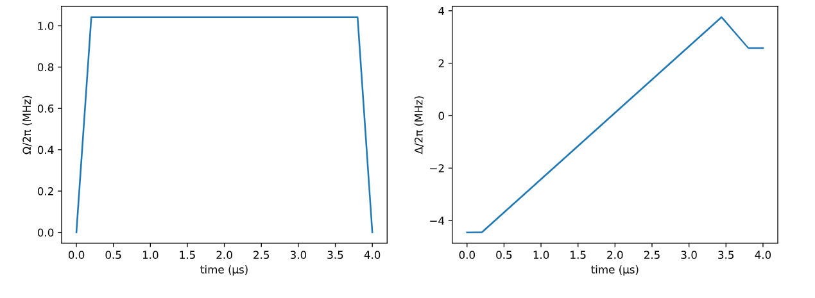
Pulse shape

Slide 14



